Slide 1
Doing Data Science
Unit 2
Jacquie Cheun
Data Science @ SMU

Slide 2
Admin notes
HW1 due today
HW2 due 1 hour before live session 3 next Tuesday

Slide 3
Main topics
Basic R programming (functions, control/loop structures)
RStudio
RMarkdown/knitr

Slide 4
Getting started with R R data types: https://www.statmethods.net/input/datatypes.html
Objects (nouns) and Functions (verbs)
#Print R session info -- why is this useful?
sessionInfo()
# c(combine) function : create vectors (elements have same types)
NumVec ← c (2, 3, 4)
CharVec ← c (“doing”, “data”, “science”)

Slide 5
# data.frame() : create an object with rows and columns
StringNumObj ← data.frame(NumVec, CharVec)
# cbind()/rbind() : combine vectors side-by-side
StringNumObjCbind ← cbind(NumVec, CharVec)
# Reassign row.names
row.names(StringNumObj) ← c("First", "Second", "Third")
Why use data.frame when we have cbind()/rbind()?
What is the difference between a matrix and a data frame?

Slide 6
# $ : component selection for data frames
NewNumeric ← StringNumObj$NumVec
# head()/tail() : select first/last few rows
data(mtcars) #load built in cars dataset
head(mtcars)
tail(mtcars)
# [rows,columns] subscript operators, : sequence operator
mtcars[3:7, ]

Slide 7
# str()
compactly display the structure of an R object
#what do you get when you apply str() to StringNumObj and StringNumObjCbind?
# summary()
display summary statistics for analysis (mean, quantiles, etc)
# dim()
retrieve or set the dimensions of an object (array, matrix, dataframe)

Slide 8
Missing/extreme values:
NA = not available
NaN = undefined
Inf = extremely small/large (infinity)

Slide 9
A note on loading packages and functions
# load ggplot2
load(ggplot2)
#only load and use one function from ggplot2
ggplot2::qplot(. . .)

Slide 10
Conditional structures and loops
# Example:
speed ← 95
If (speed > 65) {
print("Exceeding speed limit!")
} else {
print(“Below speed limit")
}
#if / if..else
If (test_express) {
statement(s) if true
} else {
statement(s) if false
}

Slide 11
# for loop
for (val in sequence)
{
statement(s)
}
# Example
for (month in 1:12)
{
print (month)
}

Slide 12
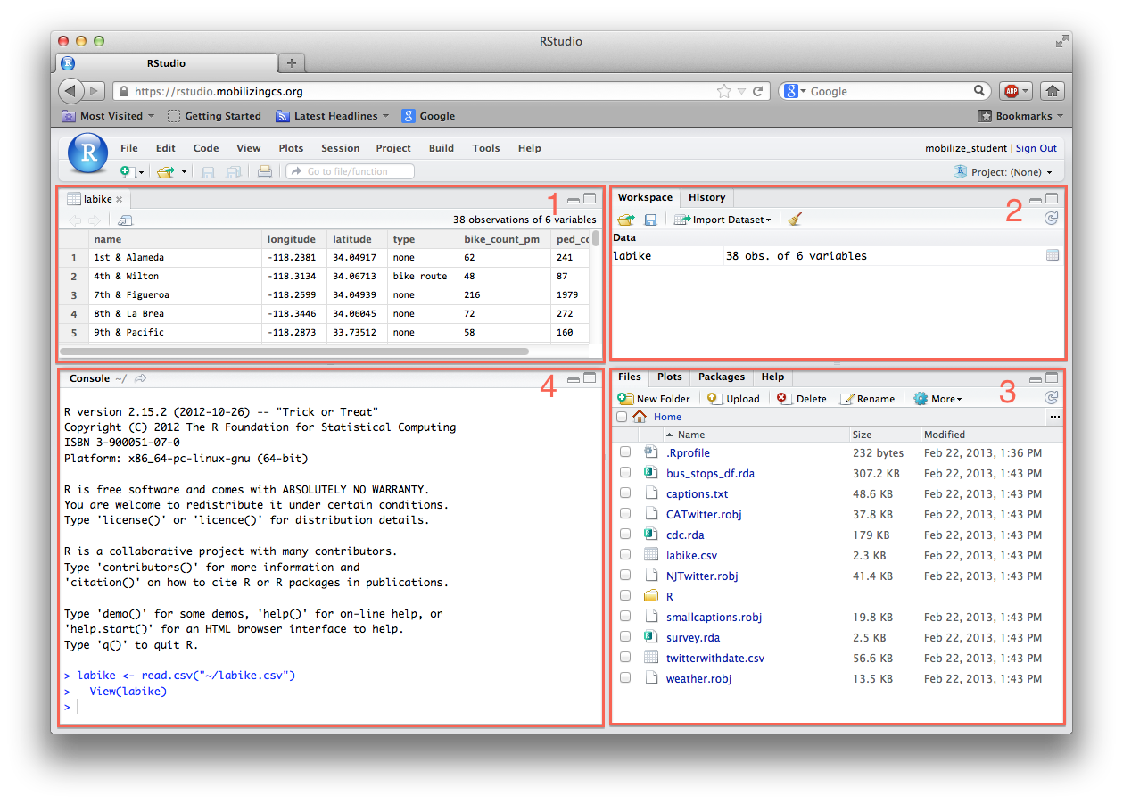
RStudio
1: View Files & Data
2: See Workspace & History
3: Files, Plots Packages & Help
4: Console

Slide 13
Breakout Session!
Implement the following function in R:
# compute the factorial of a given number
computeFactorial(x)
Example: 6! = 6 X 5 X 4 X 3 X 2 X 1 = 720
There are no factorials of negative numbers
0! = 1
R in the cloud:
Coding ground: http://www.compileonline.com/execute_r_online.php
DataCamp https://cdn.datacamp.com/dcl/standalone-example.html previously R-fiddle: www.r-fiddle.org

Slide 14
One possible solution
computeFactorial <- function(x) {
factorial = 1
#check edge conditions: negative or zero
if (x < 0) {
print("Factorials cant be computed for negative numbers")
} else if (x == 0) {
print ("The factorial of 0 is 1")
} else {
for (i in 1:x){
factorial = factorial * i
}
print (paste("The factorial of ", x, " is", factorial))
}
}

Slide 15
Demo - (2)
sessionInfo()
NumVec <- c (2, 3, 4)
CharVec <- c ("doing", "data", "science")
StringNumObj <- data.frame(NumVec, CharVec, stringAsFactors=“false”)
//note: stringAsFactors = false is needed else characters will default to factors in dataFrames
https://simplystatistics.org/2015/07/24/stringsasfactors-an-unauthorized-biography/
StringNumObjCbind <- cbind(NumVec, CharVec)
#use str
str(StringNumObj) str(StringNumObjCbind)

Slide 16
RMarkdown & knitr (http://rmarkdown.rstudio.com/articles_integration.html )
Create static/interactive documents (code, description, results)
RMarkdown uses knitr (markup) and Pandoc (document renderer)
There is also R Latex but we will mostly use R Markdown in this session.
See RMarkdown gallery for examples: http://rmarkdown.rstudio.com/gallery.html

Slide 17
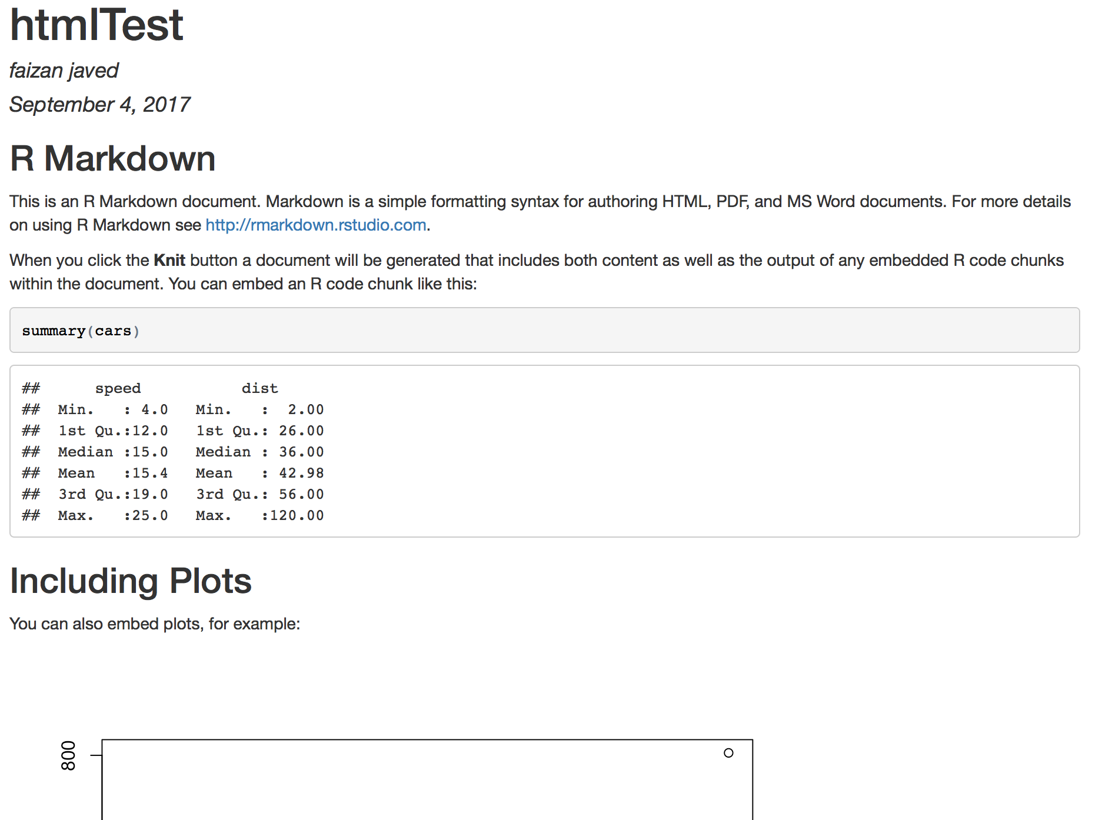

Slide 18
Global vs Local chunk options
Global:
```{r setup, include=FALSE}
knitr::opts_chunk$set(echo = TRUE)
```
Reads as: chunk label is “setup”, don’t output this code, by default output all other code chunks
Can set any chunk option as an argument to opts_chunk$set(..)

Slide 19
Local:
```{r pressure, echo=FALSE}
plot(pressure)
```
Reads as?

Slide 20
What did you learn today?
Questions?

